Slide 1
A Visit to the Doctor’s
© 2017 Lanternfish ESL at www.bogglesworldesl.com

Slide 2

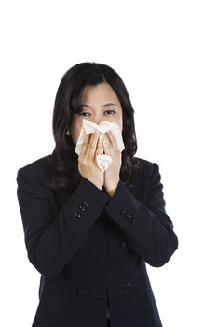
Feeling Sick
If you are feeling under the weather, you should stay home and get some rest. Many people go to work even though they are sick. They worry that the boss will be angry if they take a day off work.

Slide 3
Vocab:
If you are feeling under the weather that means you feel sick.
If you take time off of work that means you don’t go to work for a period of time. People take time off when they go on vacation or when they are sick.

Slide 4

Calling in Sick
Going to work when you have the flu is a bad idea. It will take longer for you to get better and your illness might even get worse. Also, you will spread your illness to coworkers. So if you have the flu, call in sick and stay at home.

Slide 5
Vocab:
If you are feeling better that means you are not sick anymore.
If a disease spreads that means it goes from person to person.
If you call in sick that means you telephone your work to say you are sick and will stay at home.

Slide 6
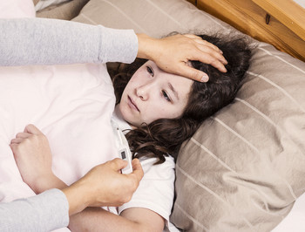
Serious Illness
If you have a minor illness such as a sore throat, you can probably just stay at home and get some rest. However, if you have a serious illness, you should see a doctor as soon as possible.

Slide 7
Vocab:
Minor is the opposite of serious.
We use minor and serious to talk about how bad an illness is.

Slide 8
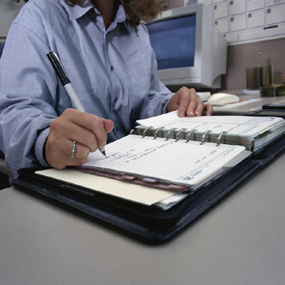
Making an Appointment
Before you visit your doctor’s clinic, you have to make an appointment. You need to call the clinic and talk to the receptionist. The receptionist will schedule an appointment for you and tell you what time the appointment is.

Slide 9
Vocab:
If you make an appointment that means you schedule a time to see someone.
A receptionist is a person who sits at a front desk, answers the phone, schedules appointments, and greets clients.

Slide 10
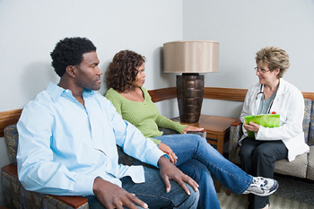
At the Clinic: The Waiting Room
When you arrive at the clinic, you need to let the receptionist know you are there. Then, you usually wait in the waiting room. Many doctors’ offices have magazines in the waiting room. You can read a magazine while you wait.

Slide 11
Vocab:
If you let someone know something that means you tell them something.
A waiting room is a place where people wait for their turn to see a doctor.

Slide 12
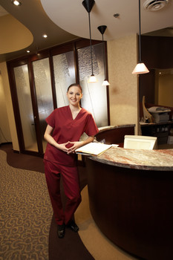
At the Clinic: The Examination Room
When it’s your turn to see the doctor, a nurse will call your name. Usually you follow the nurse to the examination room. The nurse will tell you to wait there for the doctor. Usually, you will see the doctor shortly.

Slide 13
Vocab:
If someone calls your name that means the person says your name out loud.
An examination room is a place where patients talk to the doctor in a clinic.
Shortly is another way to say soon.

Slide 14
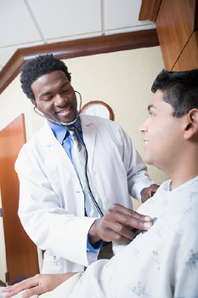
At the Clinic: The Examination Room
When the doctor comes in, you tell the doctor your symptoms. Then the doctor will examine you. The doctor might check your blood pressure or listen to you heart and lungs with a stethoscope. If you have a fever, the doctor might use a thermometer to measure your temperature.

Slide 15
Vocab:
Symptoms are the signs that you are sick. Symptoms can include a headache, a fever, a sore throat, and a cough.
A stethoscope is a tool that doctors use to listen to your heart and lungs.
A thermometer is a tool that people use to measure temperature. You use a thermometer to see if you have a fever.

Slide 16
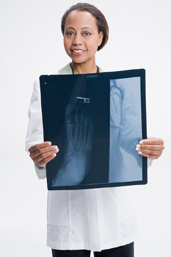
At the Clinic: Further Tests
Before the doctor can make a diagnosis, the doctor may need to do some tests. You might need an x-ray, in which case you will go to a radiologist. You may need a blood test, in which case a nurse will use a needle to draw some blood. You may need a urine test, in which case you will have to pee in a cup.

Slide 17
Vocab:
If a doctor makes a diagnosis that means the doctor tells you what your illness is.
A radiologist is a doctor that takes x-rays.
Urine is the medical term for pee.

Slide 18
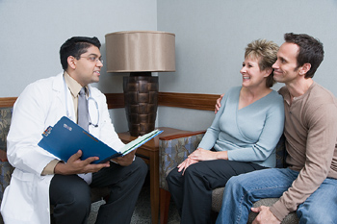
At the Clinic: The Diagnosis
After you get the test results back, the doctor will make a diagnosis and begin treatment. If it is a really serious illness, the doctor may send you to a specialist. If it is not so serious the doctor might just prescribe some medicine and send you home.

Slide 19
Vocab:
The treatment is the way or plan to cure your illness.
A specialist is a doctor who only treats one kind of disease. Specialists know a lot about that particular disease.
If a doctor prescribes some medicine that means she or he writes a note saying which medicine you need. Often, you can’t buy medicine without a prescription.

Slide 20
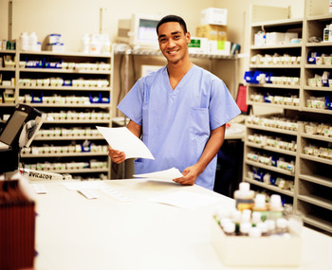
At the Pharmacy: Filling Your Prescription
If the doctor writes you a prescription, you will need to go to a pharmacy to get your prescription filled. The pharmacist will explain how to take the medicine and any potential side effects.

Slide 21
Vocab:
A pharmacy is a place where people buy medicine.
A pharmacist is a person who prepares and sells medicine.
If you get a prescription filled that means the pharmacist gives you the medicine on your prescription.
Side effects are unwanted effects that medicine may have.

Slide 22
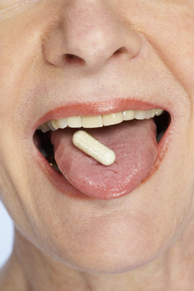
Back Home: Making a Recovery
After you pick up your medicine you can go home and get some rest. You should take your medicine as directed and drink plenty of fluids. You will be feeling better and back on your feet in no time.

Slide 23
Vocab:
If you take medicine as directed that means you follow the instructions. For example: Take three times daily after meals.
Fluids are liquids such as water, juice, and tea.
In no time is another way to say soon.

